Slide 1
TRAFFIC MANAGEMENT USING DEEP LEARNING
Guide
Mr. J. S. Pujari Sir
Prepared by,
Chintamani Naik
Yash Mudgal
Nikhil Patil
Vivek Patil
Sandeep Pandita

Slide 2
Outline
Introduction
Objectives
Product Functions
Methodologies
Implementation

Slide 3
Introduction
This project is a concept of dynamic traffic signal
Proposed as a solution to the conventional problem of
Fixed traffic signal regulations and time.
The problems faced by its manual behavior.

Slide 4
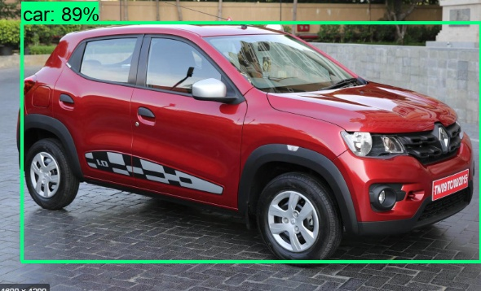
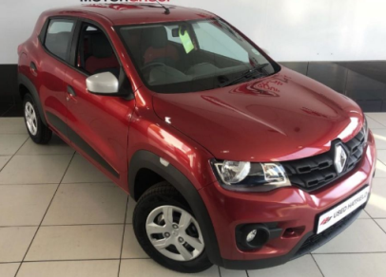
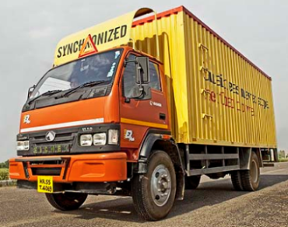
Introduction
Classification
Car Truck
Object Detection
Car
one image -> one label
one image -> labels + bounding boxes

Slide 5
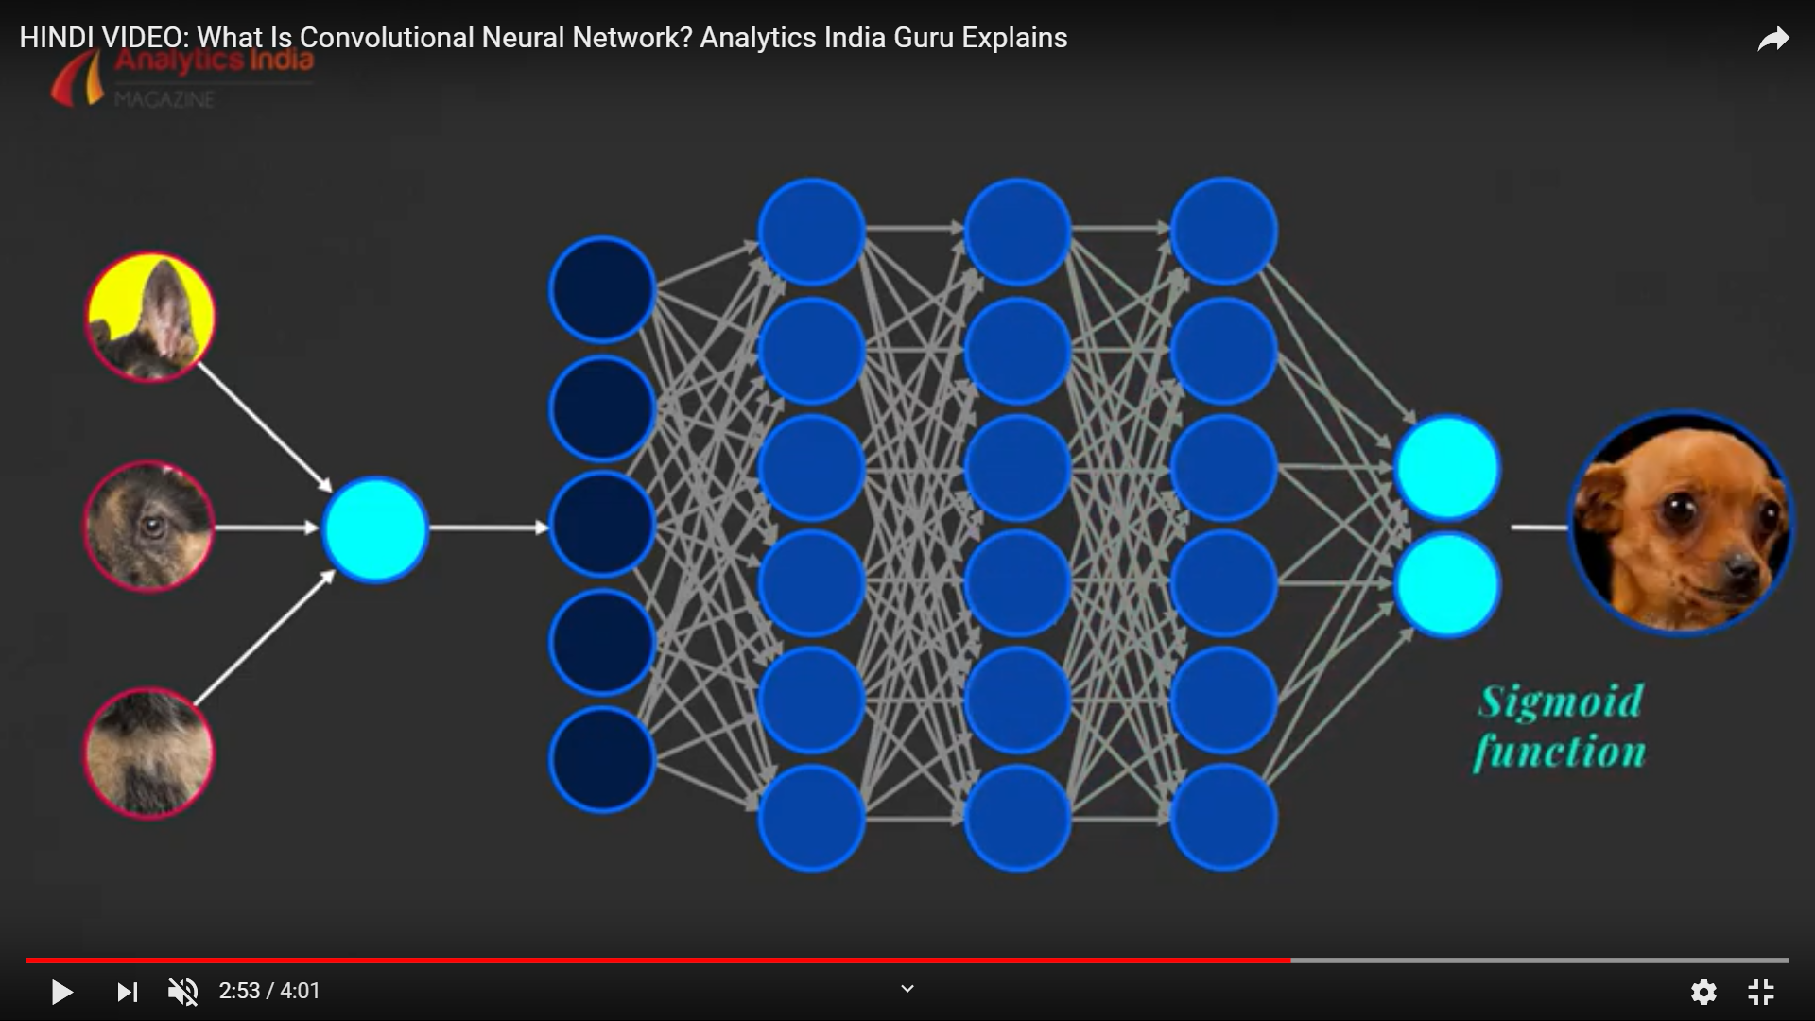
CNN Architecture

Slide 6
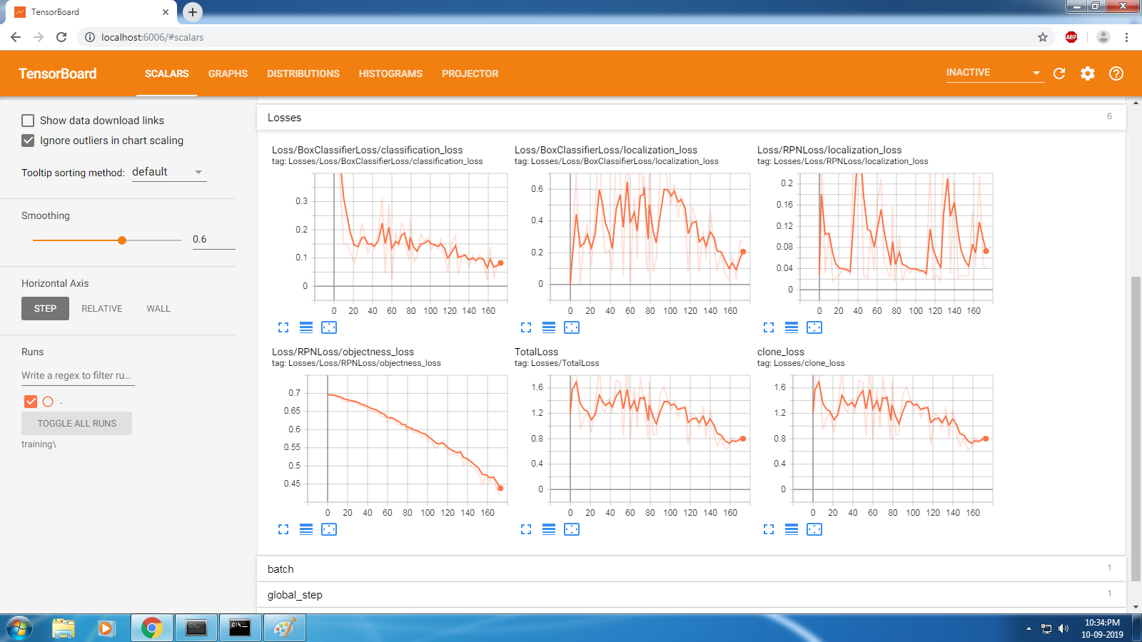

Slide 7
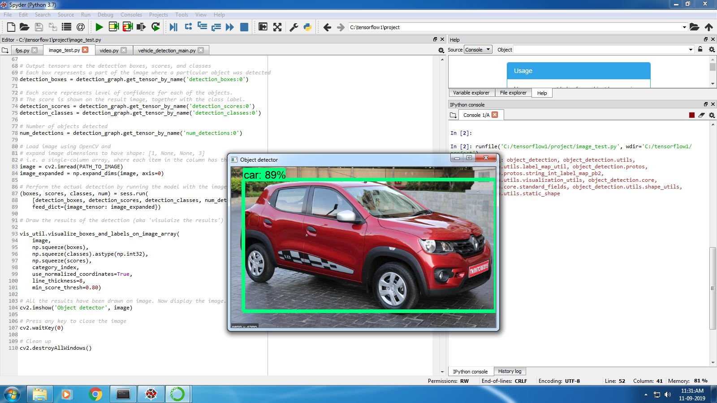

Slide 8
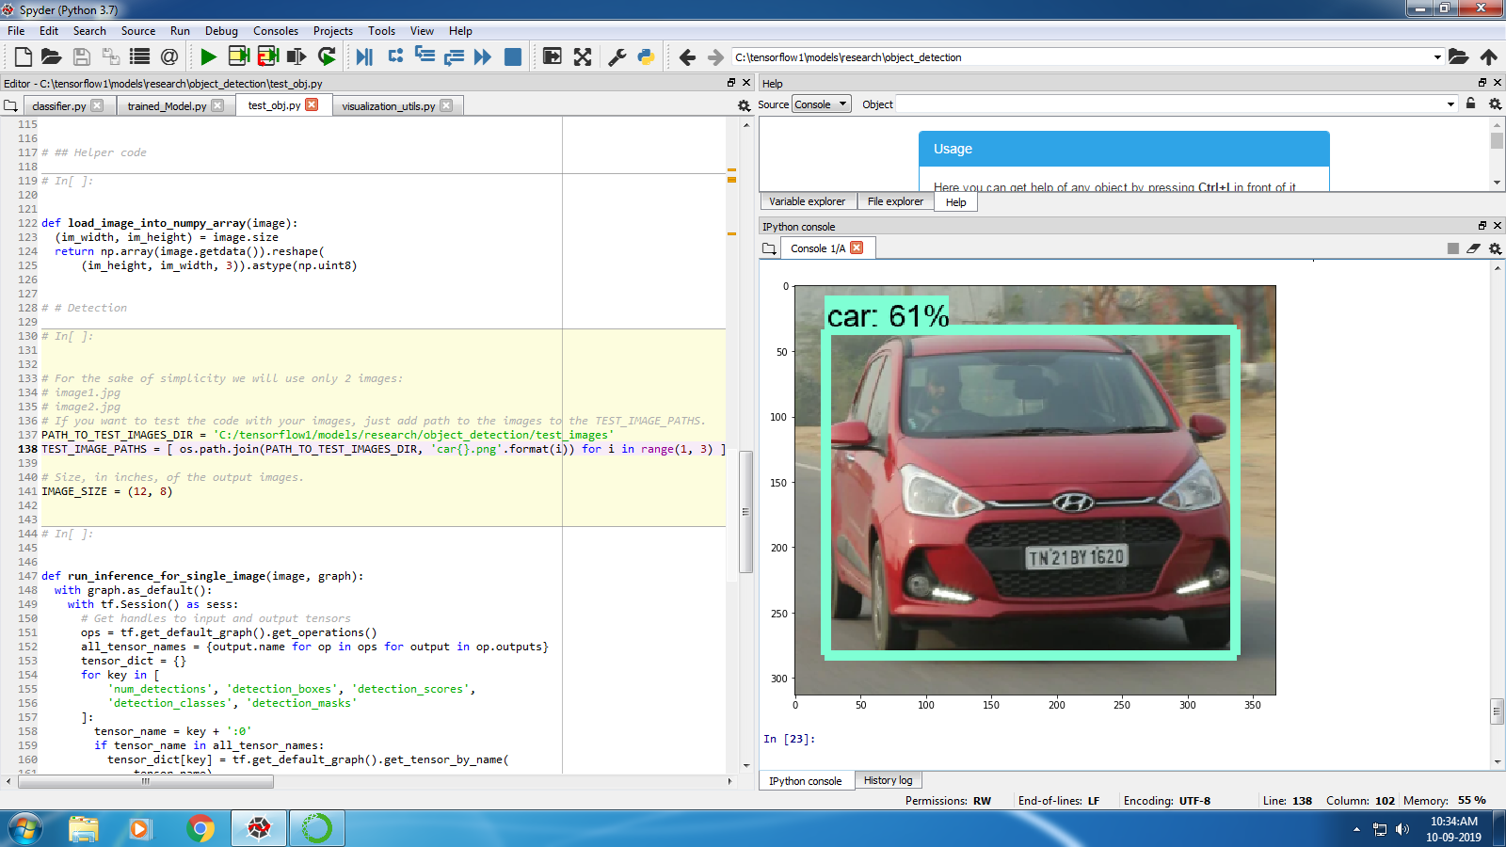

Slide 9
